Slide 1



Atliq Retail Mart Festive Sales Promotion Analysis
Atliq Mart is a retail giant with over 50 supermarkets in the southern region of India. All their 50 stores ran a massive promotion during the Diwali 2023 and Sankranti 2024 (festive time in India) on their Atliq branded products.
In order to understand which promotions did well and which did not ….
The analysis provides a presentation with actionable insights
so that the
sales director can make informed decisions for their next promotional period.
MahaLakshmi.MR
DataAnalyst

Slide 2

Atliq Retail Mart Festive Sales Promotion Analysis
Business Requests Important business questions posed by senior executives, requiring SQL-based report generation.

Slide 3
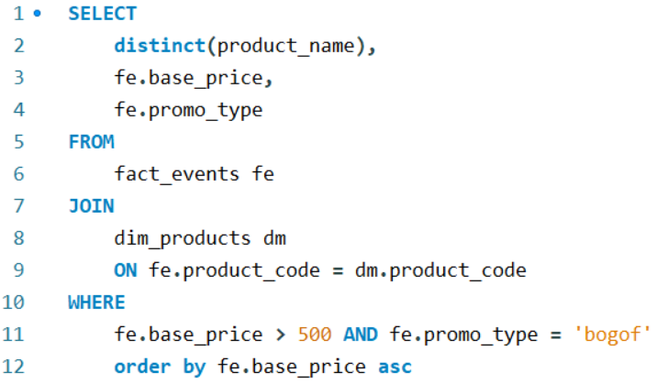
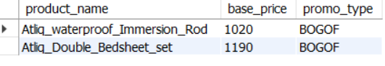
1 . List of products with a base price greater than 500 and that are featured in promo type of 'BOGOF' (Buy One Get One Free)

Slide 4
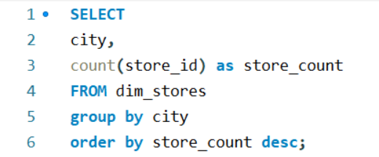
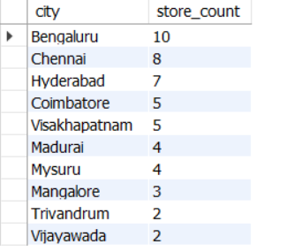
2. Report that provides an overview of the number of stores in each city. The results will be sorted in descending order of store counts. The report includes two essential fields: city and store count

Slide 5
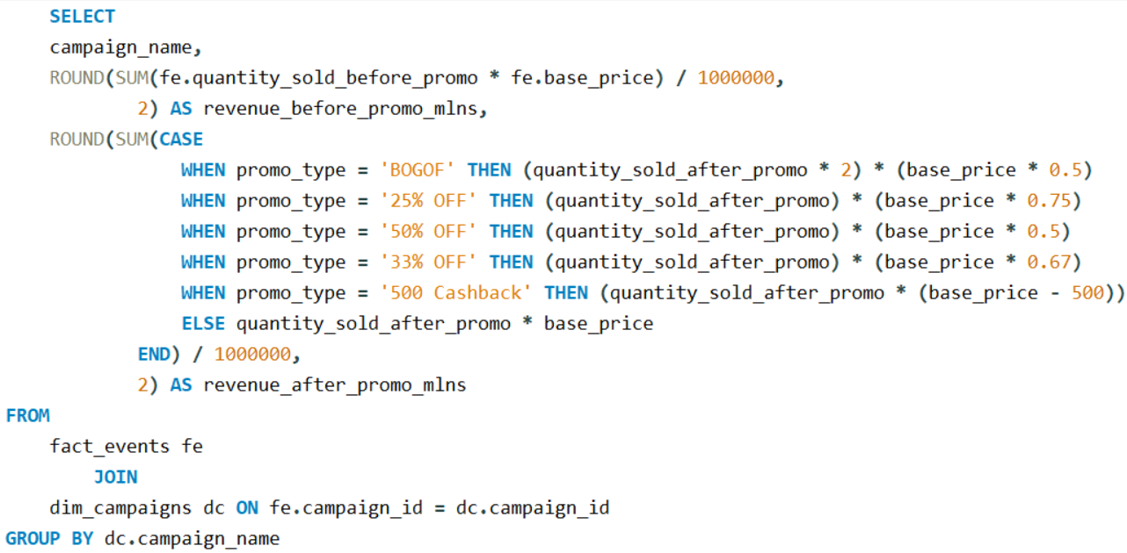
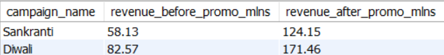
3.Report that displays each campaign along with the total revenue generated before and after the campaign?

Slide 6
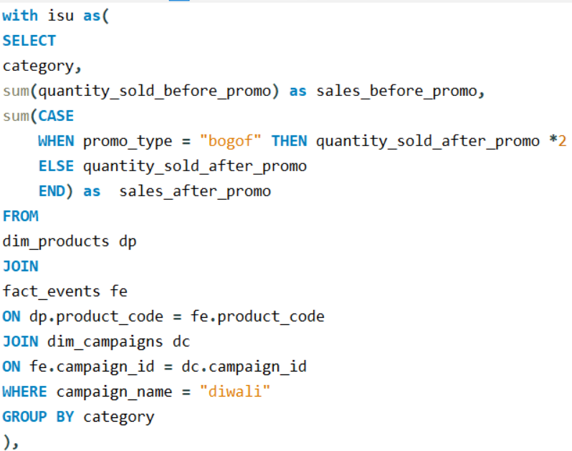
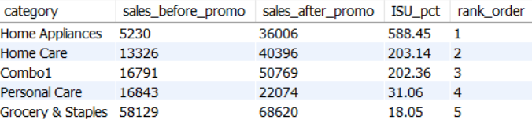
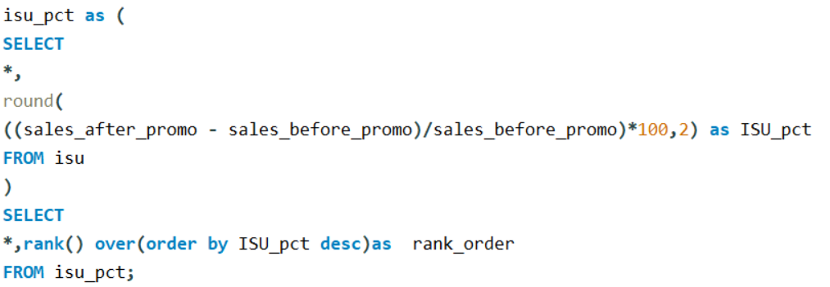
4. Report that calculates the Incremental Sold Quantity (ISU%) for each category during the Diwali campaign. & Rankings for the categories based on their ISU%.

Slide 7
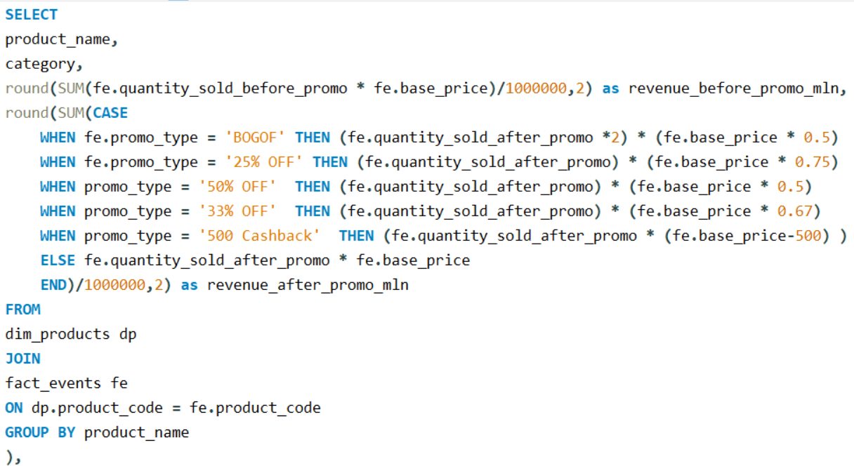
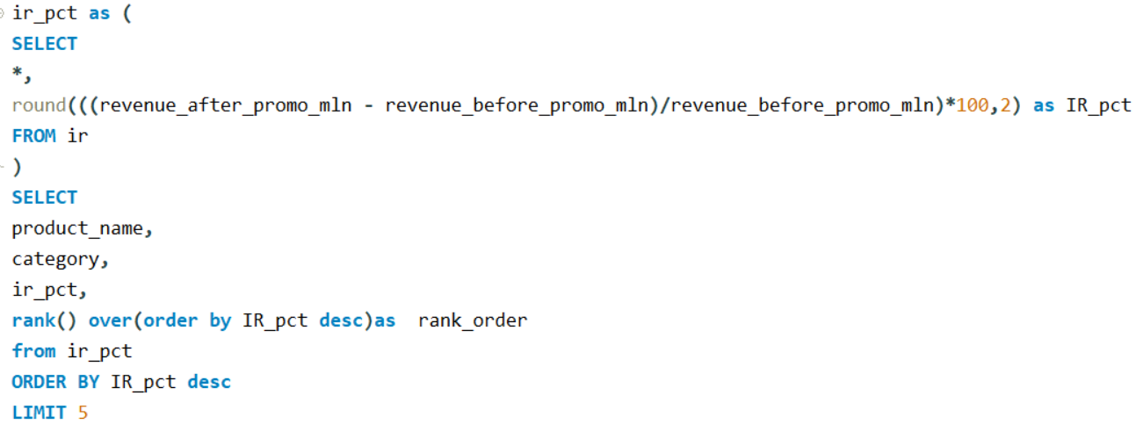
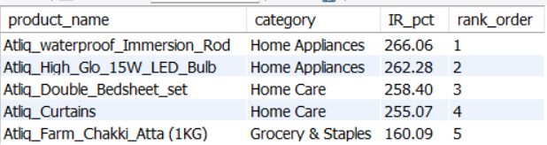
5. Report featuring the Top 5 products, ranked by Incremental Revenue Percentage (IR%), across all campaigns.

Slide 8
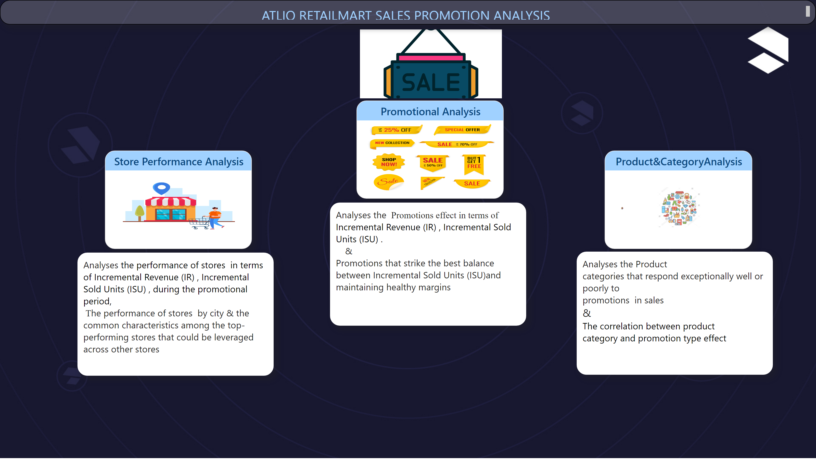
Home
Notes:
Store Performance Analysis
No alt text provided
textbox
No alt text provided
Promotional Analysis
No alt text provided
textbox
No alt text provided
Product&CategoryAnalysis
No alt text provided
textbox
No alt text provided
image
No alt text provided
image
No alt text provided
textbox
No alt text provided

Slide 9
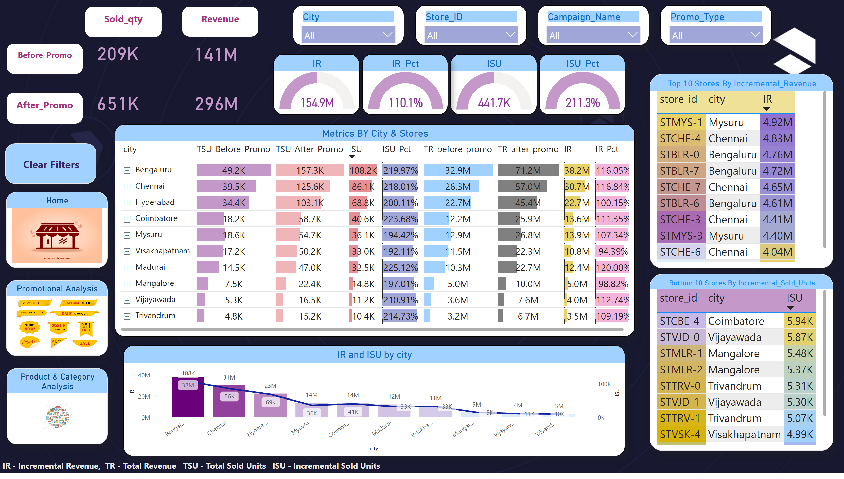
Store_Performance_Analysis
Notes:
Top 10 Stores By Incremental_Revenue
No alt text provided
Bottom 10 Stores By Incremental_Sold_Units
No alt text provided
slicer
No alt text provided
slicer
No alt text provided
slicer
No alt text provided
Metrics BY City & Stores
No alt text provided
gauge
No alt text provided
gauge
No alt text provided
slicer
No alt text provided
lineClusteredColumnComboChart
No alt text provided
textbox
No alt text provided
actionButton
No alt text provided
gauge
No alt text provided
Promotional Analysis
No alt text provided
Product & Category Analysis
No alt text provided
Home
No alt text provided
Before_promo
No alt text provided
Before_promo
No alt text provided
Before_promo
No alt text provided
Before_promo
No alt text provided
card
No alt text provided
card
No alt text provided
card
No alt text provided
card
No alt text provided
gauge
No alt text provided

Slide 10
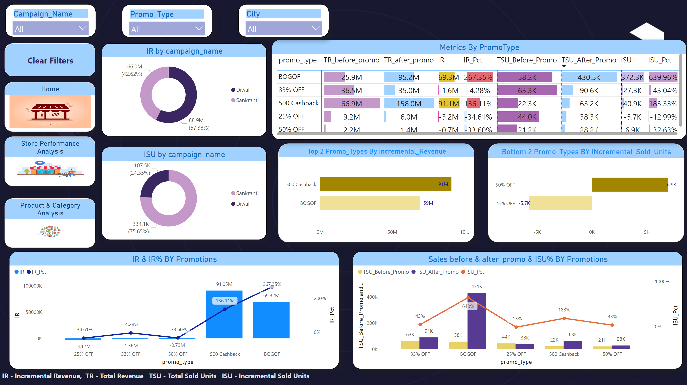
Promotional_Analysis
Notes:
slicer
No alt text provided
slicer
No alt text provided
Top 2 Promo_Types By Incremental_Revenue
No alt text provided
Bottom 2 Promo_Types BY INcremental_Sold_Units
No alt text provided
Sales before & after_promo & ISU% BY Promotions
No alt text provided
actionButton
No alt text provided
textbox
No alt text provided
Store Performance Analysis
No alt text provided
Home
No alt text provided
Product & Category Analysis
No alt text provided
IR & IR% BY Promotions
No alt text provided
donutChart
No alt text provided
donutChart
No alt text provided
Metrics By PromoType
No alt text provided
slicer
No alt text provided

Slide 11
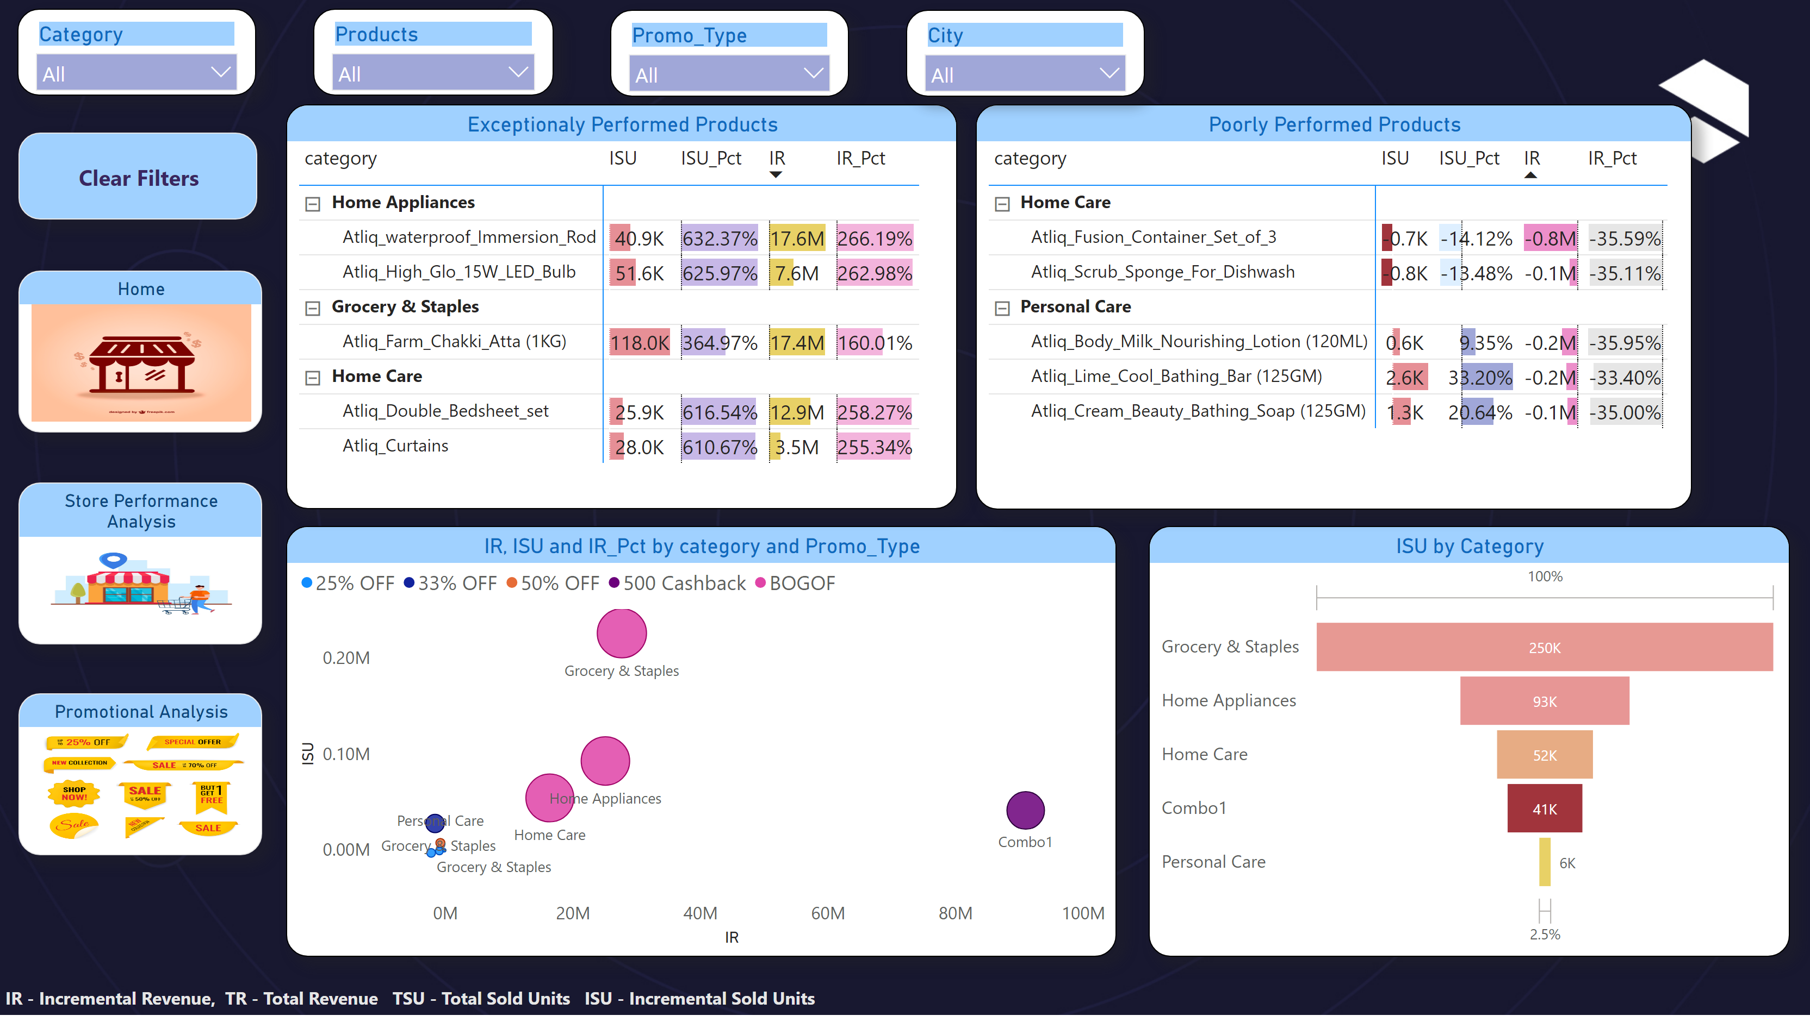
Product&Category_Analysis
Notes:
slicer
No alt text provided
slicer
No alt text provided
scatterChart
No alt text provided
textbox
No alt text provided
Home
No alt text provided
actionButton
No alt text provided
slicer
No alt text provided
Store Performance Analysis
No alt text provided
Promotional Analysis
No alt text provided
funnel
No alt text provided
Exceptionaly Performed Products
No alt text provided
Poorly Performed Products
No alt text provided
slicer
No alt text provided

Slide 12


Atliq Retail Mart Festive Sales Promotion Analysis
MahaLakshmi.MR
DataAnalyst

